Slide 1
DATA 607 FINAL PROJECT
Shyam Balagurumurthy-Viswanathan, Liam Byrne, and Oluwakemi Omotunde
Notes:
Good evening everyone,
We will be presenting today our final project for this class. I must say that this is a very interesting take on. We just wanted to walk you through our thought process and what we did. We will be sharing the link to the github repo for those who want to take a closer look.

Slide 2
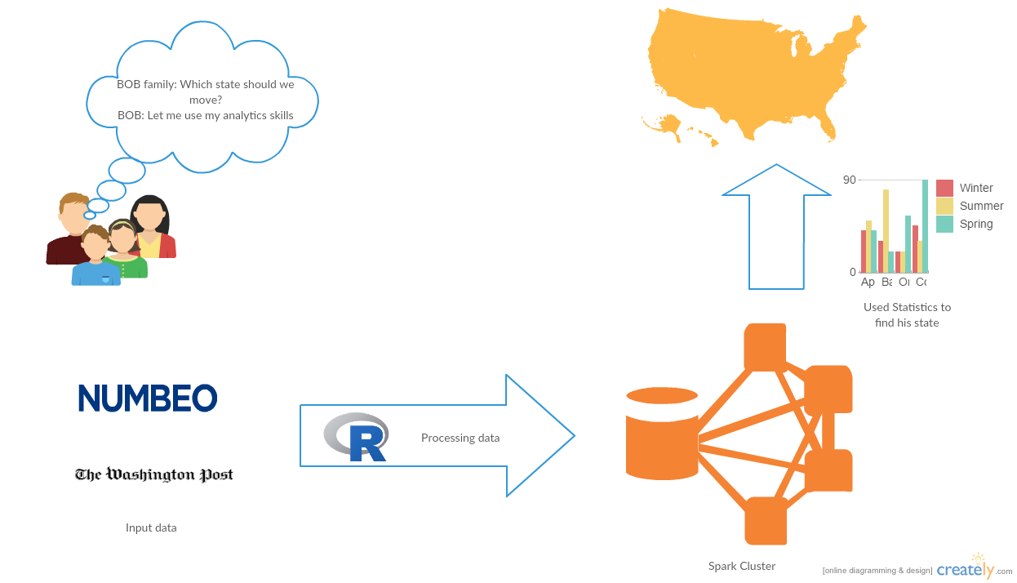
Work Flow
Notes:
This is our workflow; Bob’s big question was “How do I use these skills I just learned to pick a place for my family and I?”
Once we knew our question, we started digging for data. We were lucky to find Numbeo, which is great. We also used a data set that we found when exploring the Shiny app examples. We scrapped indeed for our salary information and Zillow for the rental property link in our findings. Next we used Spark for modeling and finally visualizing and communicating our data with you guys.

Slide 3

PROBLEM
Bob is a recent graduate of the CUNY MSDA Program and is now faced with the decision on where he should live with his family.
Wants to utilize data that is available to help with decision
Notes:
So what problem were we looking to solve? Well Bob is a recent graduate of the CUNY MSDA program and now that he’s graduated, he wants to put down roots somewhere but where whereby he’s making the most money for his job title, safe for his kids; a place that meets most, if not all his requirements? We are going to take a data science approach to getting Bob and answer.

Slide 4
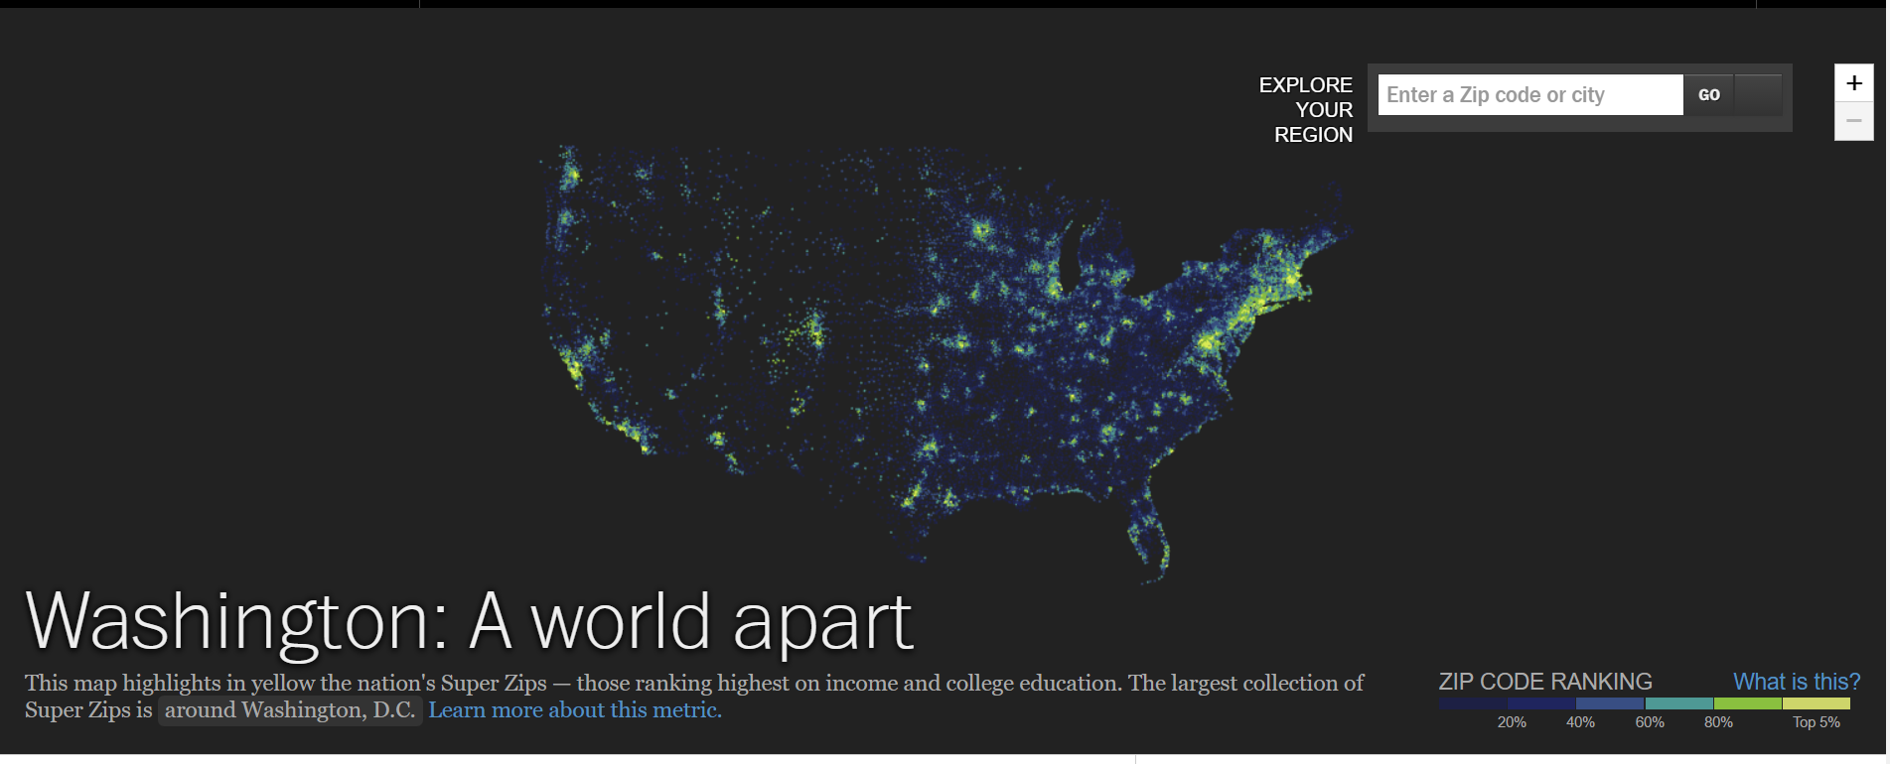
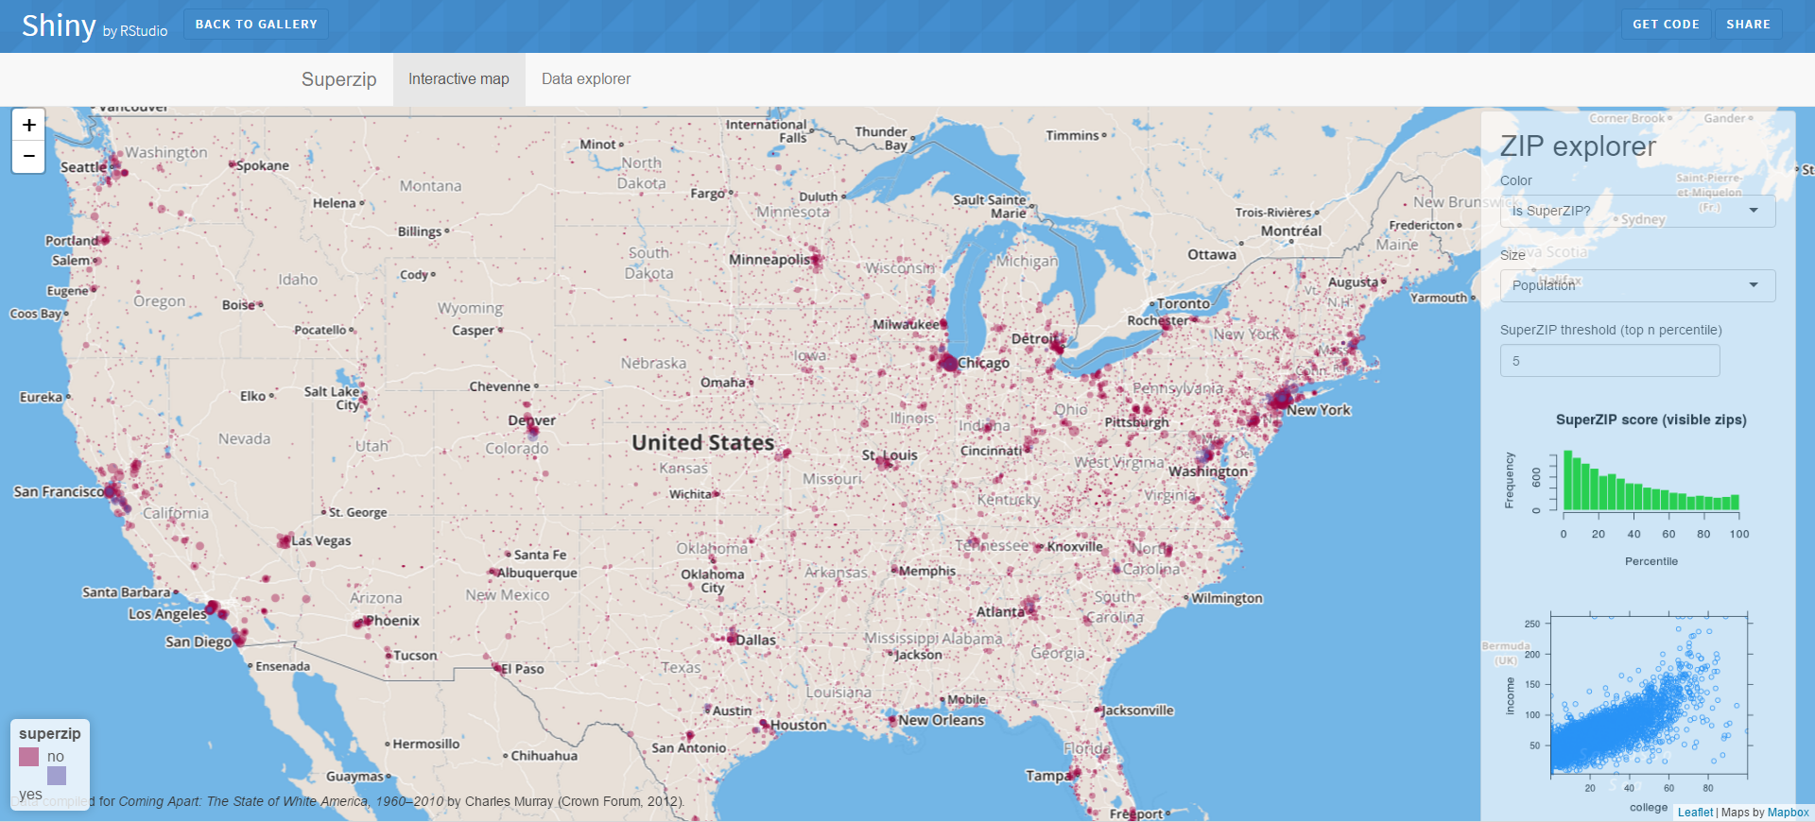
Sources Built On
superZips.rds: Data originally used in the Washington Post's interactive feature Washington: A world apart, which ranked zip codes by education and income.
Rstudio Shiny App Example, which utilized the data from superZips in an interactive map feature.

Slide 5
Data Collection and Preparation
Numbeo API - Provides current information on world living conditions including cost of living, housing indicators, health care, traffic, crime and pollution.
Numbeo indexes gathered for all cities in the United States via API,. NAs filled by copying indexes of the closest city by minimizing lat\long difference.
Ranked Numbeo indexes by city.
Merged data from Numbeo and superZips.rds then uploaded to Spark
Notes:
So first step was to collect our data. We started out wanting to exploit both the Numbeo API as well as the Zillow API but things changed the further we got into the project. We ended up using data from Numbeo and this shiny example that we found VIA RStudio. One issue we had was that the Numbeo data frame was organized by city

Slide 6
How it Works
Desired job – Input used to scrape Indeed.com’s salary information by location.
# of bedrooms – Input used in search criteria for Zillow housing scrape.
Select parameters to rank and color by:
Indexes from Numbeo such as traffic, pollution and health care.
Median income, % of population with degrees, etc from superZip data
Clicking on city will display all ranked items, average salary for the job selected and a Zillow link for housing meeting the criteria of rent <= 30% of the selected job’s salary and it has the # of rooms desired.
Spark is the workhorse throughout; providing fast, dynamic processing of data for tables, visualizations and analysis.

Slide 7

Data Modeling and Hosting
sparklyr - R interface for Apache Spark
Open-source cluster computing framework.
In-memory primitives provide performance up to 100 times faster for certain applications.
Provides a complete dplyr backend.
AWS for app hosting.

Slide 8
A Tour of the Shiny App
Let’s take a tour of the application in action.
Click here to run.

Slide 9
Further Steps?
Expand the location possibilities to be worldwide
Widen parameters
Perhaps utilize a survey to get an idea of what people look for when relocating.

